Slide 1


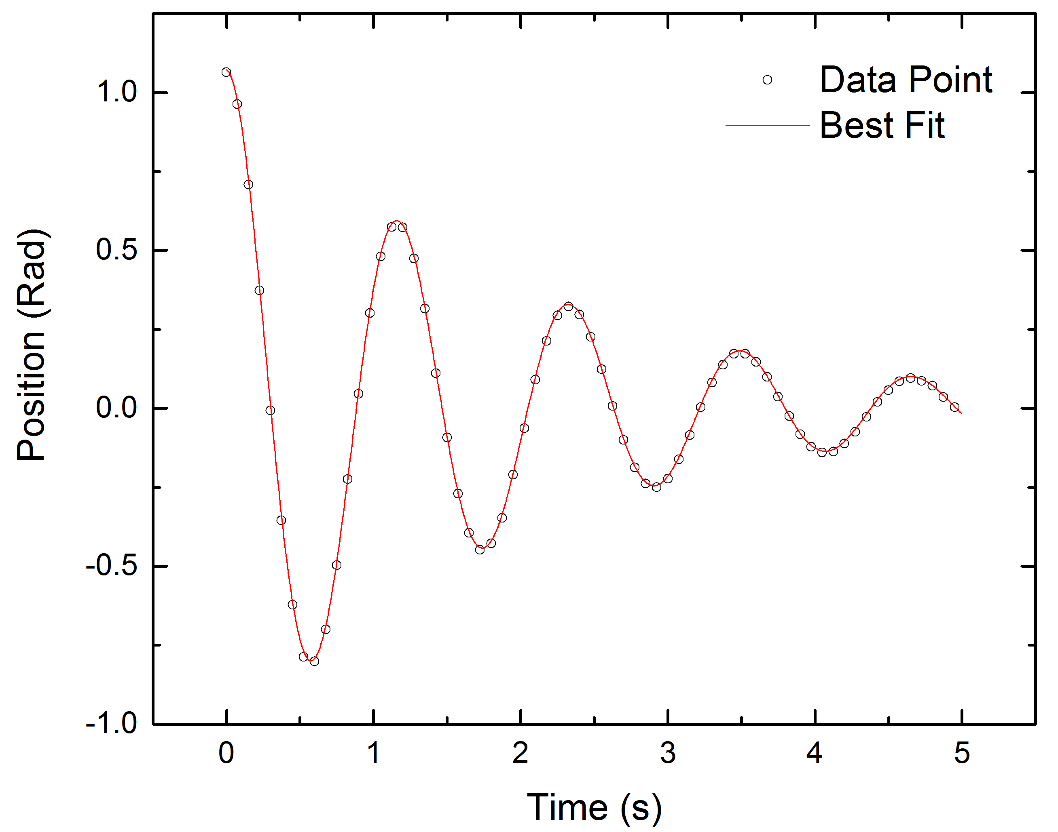
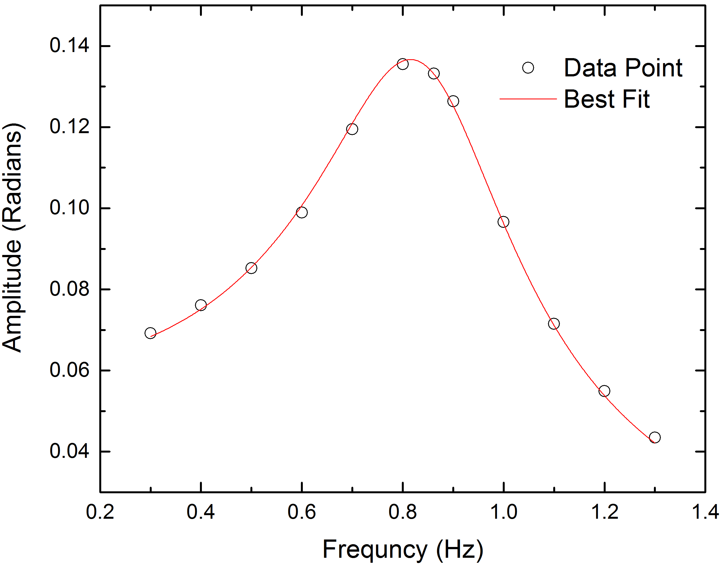
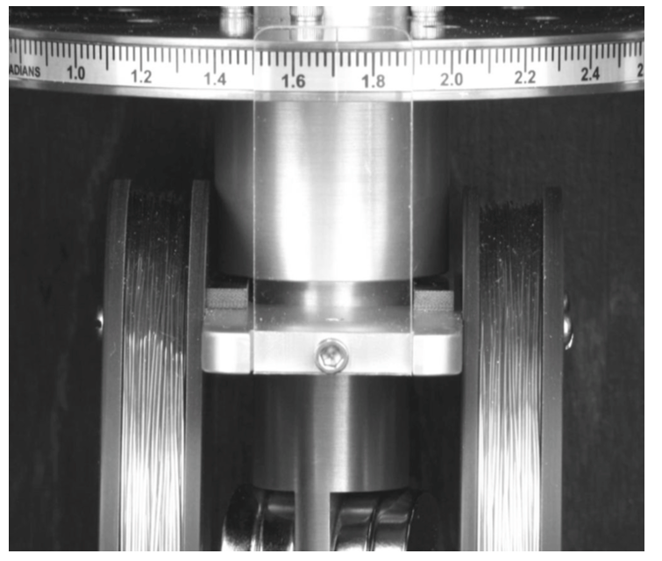
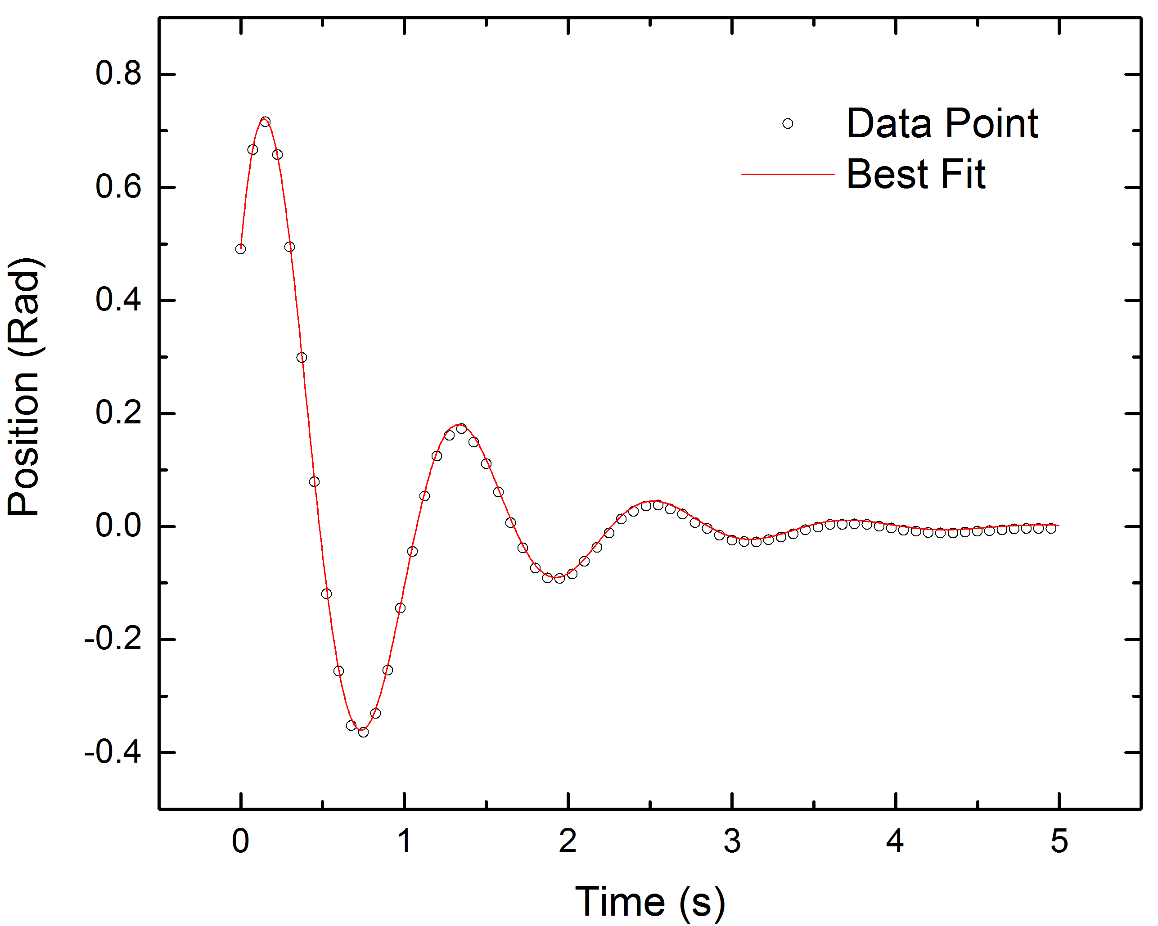
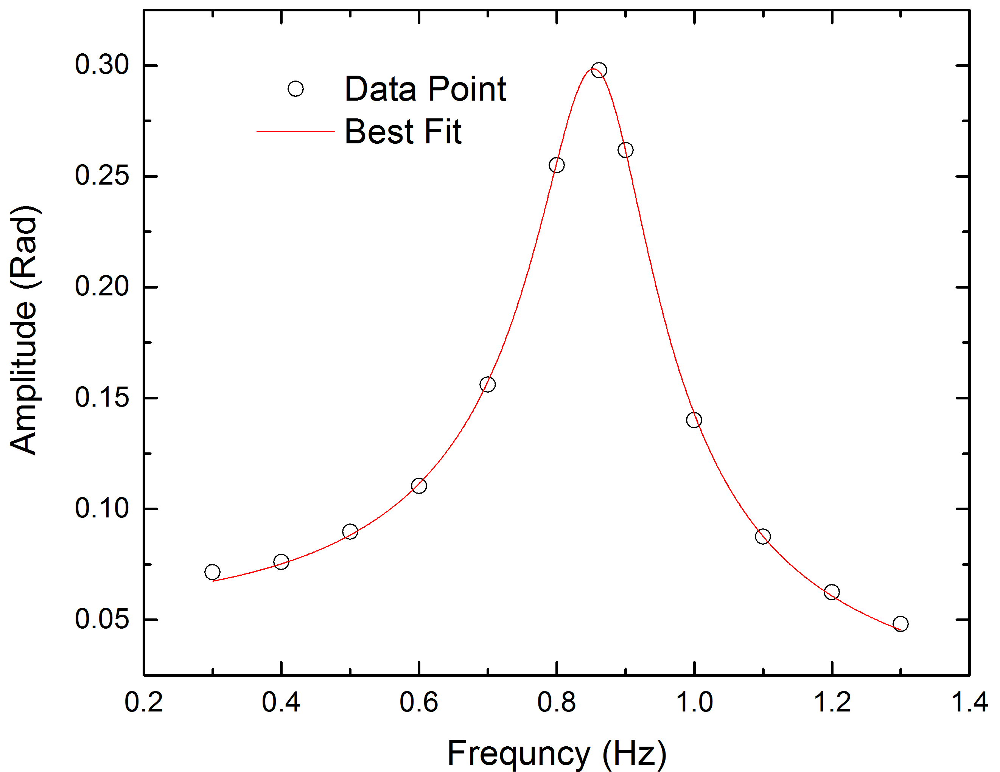
Determining the Damping Coefficient from the Dynamics of a Torsion Oscillator
Michael Conrad, Faculty Sponsors: Jim Hetrick and Vaman Naik
conradma@umich.edu, jameshet@umich.edu, vmnaik@umich.edu
Abstract
The angular position as a function of time of a torsion oscillator was measured and fit with a theoretical model that assumed a linear restoring force and damping (due to Eddy currents) proportional to the angular speed. Underdamped oscillations, at two different levels of damping, were analyzed. The damping coefficient for each case was obtained from a fit of the decaying oscillation with the theoretical model, yielding (0.5074 ± 0.0008) s⁻¹ and (1.167 ± 0.002) s⁻¹ for “light” and “heavy” damping, respectively. For the same levels of damping the oscillator was driven with a sinusoidally varying torque whose frequency was swept through the oscillator’s natural frequency. The steady state amplitude as a function of driving frequency exhibited a resonance peak. A fit of these resonance curves provided an alternate method for determining the damping coefficients, which were found to be (0.542 ± 0.005) s⁻¹ and (1.24 ± 0.01) s⁻¹ for the two cases.
Methods
For this experiment, we used the TeachSpin Torsion Oscillator² shown below. The oscillating component is a cable attached to a rotor. This instrument can measure the displacement of the rotor as well as its velocity. Eddy currents can apply a damping force and a function generator can supply a driving force.
Our first method for determining the damping coefficients is to set the rotor oscillating while a damping force is being applied. In the absence of a driving frequency, the position function will follow the transient solution until it decays to zero. The transient solution is taken from the equation of motion such that
We record the displacement from the rest position at different time intervals and fit it according to the transient solution in order to solve for the damping coefficient.
Our second method for calculating the damping coefficient is to apply a driving force and measure the maximum amplitude of the rotor at different driving frequencies. These maximum amplitudes are resonance peaks and they can be fit to amplitude of the steady state solution of the equation of motion. This amplitude is
We performed both of these experiments at two different levels of damping: light and heavy and used these two methods to calculate the respective damping coefficients. From these results we are able to compare not only the two distinct methods of measuring the damping coefficient, but also how two different damping coefficients behave under each model.
Results
The angular displacement of the rotor over time under the influence of the light damping force and in the absence of a driving force.
The angular displacement of the rotor over time under the influence of the heavy damping force. This is a larger damping coefficient as the amplitude decays to zero much more quickly.
The maximum of the amplitude of the steady state component of the damped driven harmonic oscillator at different driving frequencies for the light level of damping. Note the natural frequency of the oscillator is (0.863 ± 0.003) s⁻¹.
The maximum of the amplitude of the steady state component of the damped driven harmonic oscillator at different driving frequencies for the heavy level of damping. Note the broader peak as a results of the larger damping coefficient.
Fitting our measurements for the lightly damped oscillator to the transient state of the equations of motion yielded a damping coefficient of (0.508 ± 0.001) s⁻¹. Fitting our measurements for the resonance curve yields a damping coefficient of (0.542 ± 0.006) s⁻¹.
For the heavily damped oscillator we calculated a damping coefficient of (1.167 ± 0.003) s⁻¹ for the method without a driving force. For the method with the driving force we calculated our damping coefficient to be (1.234 ± 0.012) s⁻¹.
Objectives
We use the TeachSpin Torsional Oscillator to model a simple harmonic oscillator. This model can be made more complex by adding a damping and driving force. By exploring how the amplitude of a dampened driven oscillator behaves over time we can understand the interaction between these forces through measurable quantities.
First we need to model the three forces acting on the system: the restoring force, the damping force, and the driving force¹.
We also need to define the damping coefficient and the natural frequency of the oscillator.
We can now solve for the equation of motion of the oscillator.
Where¹
We can measure system parameters like position, amplitude, and resonance in order to experimentally confirm that this theoretical model matches experimental results.
Conclusions
Using Teachspin’s Torsional Oscillator we were able to measure two damping coefficients, light and heavy, using two different methods. For both of these damping levels, the damping coefficients were not within measurement errors of each other. This could be due to some assumptions we made in deriving our equation of motion. Foremost, we assumed that the damping force, and therefore the damping coefficient, was a force that depends linearly on position. The damping force may be related to position at some higher order or in some way be dependent on velocity. Further research could model the damping force in different ways in order to strive for greater compatibility between the two methods.
References
¹Marion and Thorton. Classical Dynamics of Particles and Systems. Belmont, CA, Thomson, 2004 p. 100.
²Teachspin Manual. TeachSpin Torsion Oscillator. p. 1.

